Slide 1




Open-Source Software The Good, The Bad and The Ugly
Jinhong Brejnholt
Saxo Bank
jbrejnholt

Slide 2



jbrejnholt

Slide 3
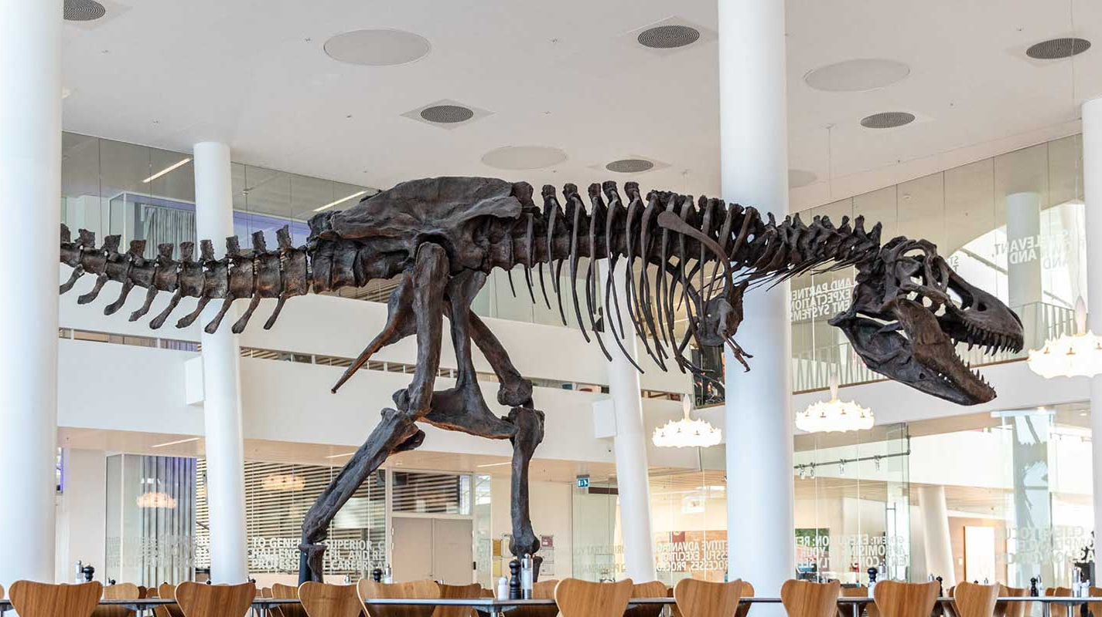
jbrejnholt
Notes:
“Saxo Bank is a very different bank, and we want our environment to reflect that. The T-Rex that hangs in the canteen reminds us that we need to remain agile and be on the leading edge of technology developments so that we can continue to help our clients and partners navigate the global markets. In other words, we cannot become dinosaurs.” --Kim Fournais, CEO and Founder, Saxo Bank
Saxo Bank is a Danish investment bank specializing in online trading and investment. It was founded as a brokerage firm in 1992, under the name Midas Fondsmæglerselskab, by Lars Seier Christensen, Kim Fournais, and Marc Hauschildt. The name was changed to Saxo when the company obtained a banking license in 2001.
Saxo Bank A/S is a fully licensed and regulated Danish bank with an online trading platform that empowers you to invest across global financial markets.

Slide 4
Agenda
Background
Good/Bad/Ugly
How-to
Q&A
jbrejnholt

Slide 5
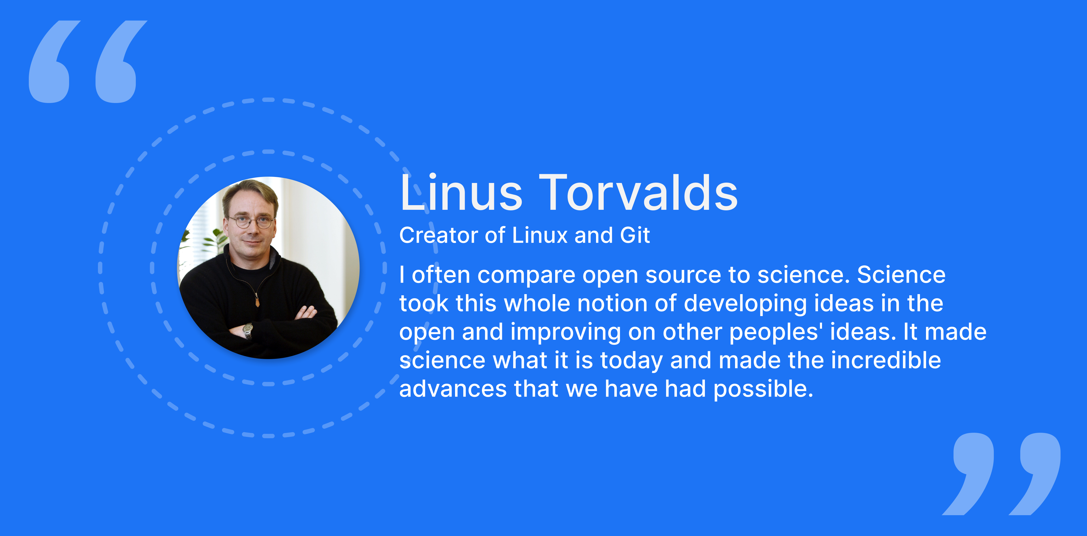
jbrejnholt

Slide 6
What’s Open-Source Software
1. Free Redistribution
2. Allow distribution of source Code
3. Allow derived Works
4. Integrity of The Author’s Source Code
5. No Discrimination Against Persons or Groups
6. No Discrimination Against Fields of Endeavor
7. Distribution of License
8. License Must Not Be Specific to a Product
9. License Must Not Restrict Other Software
10. License Must Be Technology-Neutral
Notes:
Open-source software (OSS) is computer software that is released under a license in which the copyright holder grants users the rights to use, study, change, and distribute the software and its source code to anyone and for any purpose.^{[1][2]}
Open-source software may be developed in a collaborative, public manner.

Slide 7

What’s Open-Source Software
Ensure freedom
1
Set condition
2
Protect Developers
3
jbrejnholt
Notes:
Ensure Freedom: Guarantee that the software remains open and that users have the freedom to view, modify, and distribute the source code.
Set Conditions: While maintaining the software’s openness, outline conditions under which it can be used, modified, or distributed.
Protect Developers: Safeguard the original developers from liabilities arising from the software’s use.

Slide 8









History
1990 accelerating
Popular adoption
Long time ago
1985 - GNU
1970
Close source
1990’s
Closed Groups collaboration
Late 90’s Gained public acceptance
jbrejnholt
Notes:
Popular adoption

Slide 9
According to the Boston Consulting Group, over 99% of Fortune 500 companies have incorporated Open-Source Software into their operations.
jbrejnholt
Notes:
This statistic underscores the growing significance of OSS in the corporate landscape - 2021

Slide 10
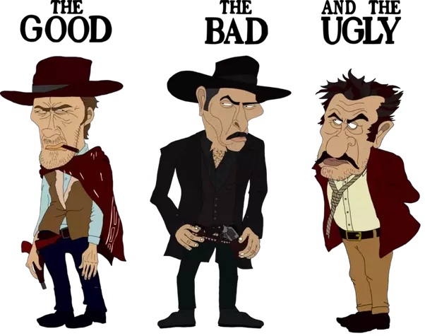
Good/Bad/Ugly of OSS
jbrejnholt

Slide 11
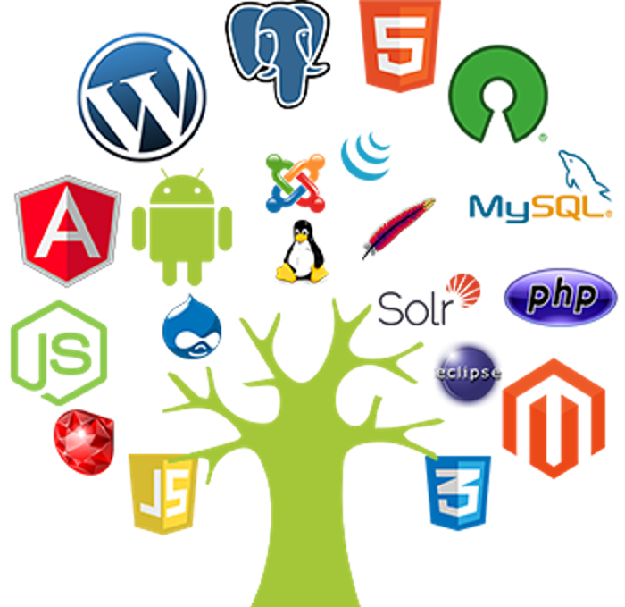
The Good
Licensed to use
Transparency
Easy integration
No vendor lock-in
Quality & flexibility
Great learning source
Environmentally friendly
jbrejnholt

Slide 12

The Bad
Common Vulnerabilities and Exposures
Community Support
License Management
jbrejnholt

Slide 13
Copyleft vs Permissive
A copyleft license mandates that any code evolved from the original open-source code must retain its licensing conditions.
A permissive license offers greater flexibility in terms of reusing, altering, and distributing the code.
jbrejnholt

Slide 14

The Ugly
Commercial companies have changed their license conditions from a rather business friendly i.e. with very few (if any) obligations, to a more restrictive licenses in newer versions of the software.
jbrejnholt

Slide 15



The Ugly
BSL
10th Aug 2023, HashiCorp has decided to transition from the open-source model that initially propelled its products to the source-available Business Source License (BSL) v1.1.
jbrejnholt

Slide 16
Mozilla Public License (MPL) VS Business Source License (BSL)
MPL is a free and open-source license created by the Mozilla Foundation.
The BSL is not an open-source license but is instead a source-available license.
BSL
jbrejnholt
Notes:
The idea of BSL is to prevent cloud providers or other businesses from offering the software as a commercial service without contributing back or paying the original developers.
Often the transition is the opposite, when BSL-licensed software becomes open-sourced after a period.

Slide 17
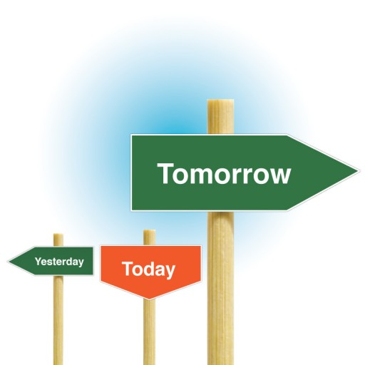
How to use OSS safely
Pick an OSS with a future
jbrejnholt
Notes:
Distributed ownership
Level playing field
De-risking open source
Open community governance

Slide 18

OSS with a future
Great community support
Active release cycle
Well maintained documentation
Accept new contributions
jbrejnholt
Notes:
Distributed ownership
Level playing field
De-risking open source
Open community governance

Slide 19
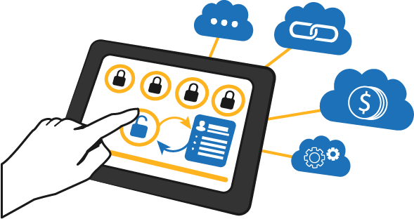
How to use OSS safely
Pick an OSS with a future
Start license management
jbrejnholt
Notes:
Distributed ownership
Level playing field
De-risking open source
Open community governance

Slide 20

Start license management
Identify own software purpose
Select permissive license when possible
Identify blacklist
Use software/automation to stay compliant
jbrejnholt

Slide 21
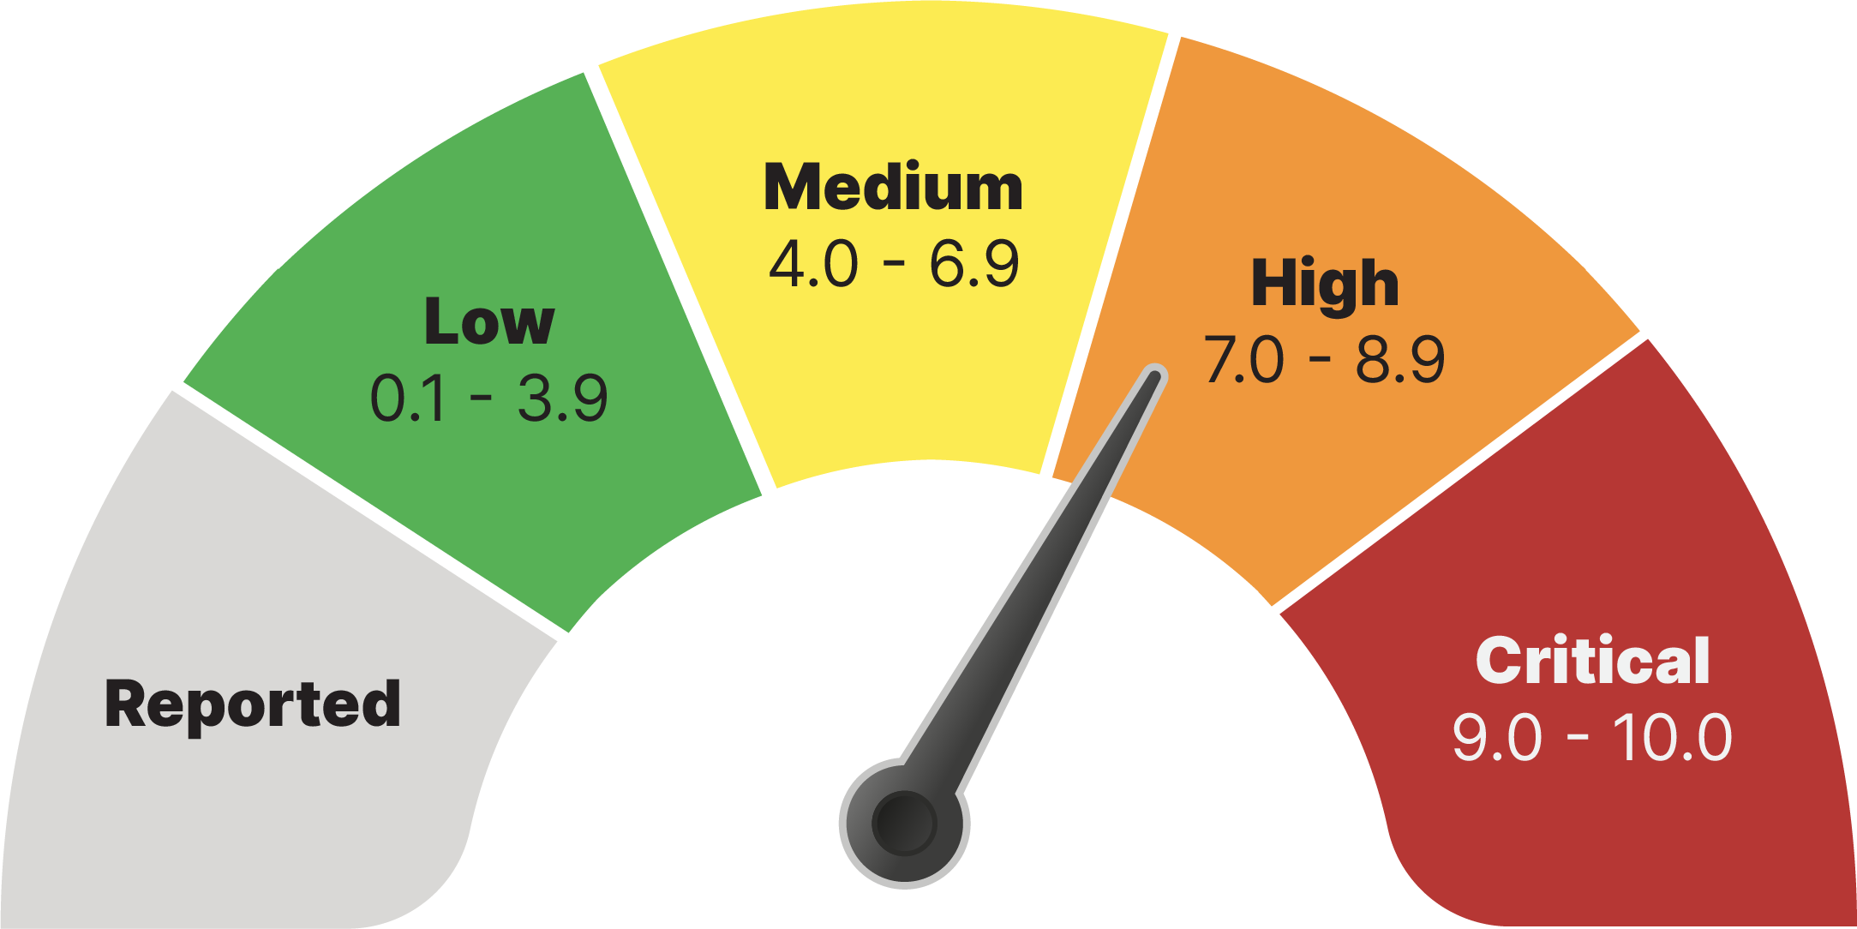
How to use OSS safely
Pick an OSS with a future
Start license management
Start CVE management
jbrejnholt

Slide 22

CVE Management
Shift left scan early
Establish process for remediation
Start with a low bar
Check execution paths
Allow security exception
Monitoring workloads at runtime
Establish process for incident response and forensics
jbrejnholt

Slide 23

How to use OSS safely
Pick an OSS with a future
Start license management
Start CVE management
Get involved
jbrejnholt
Notes:
1% user contribute back

Slide 24
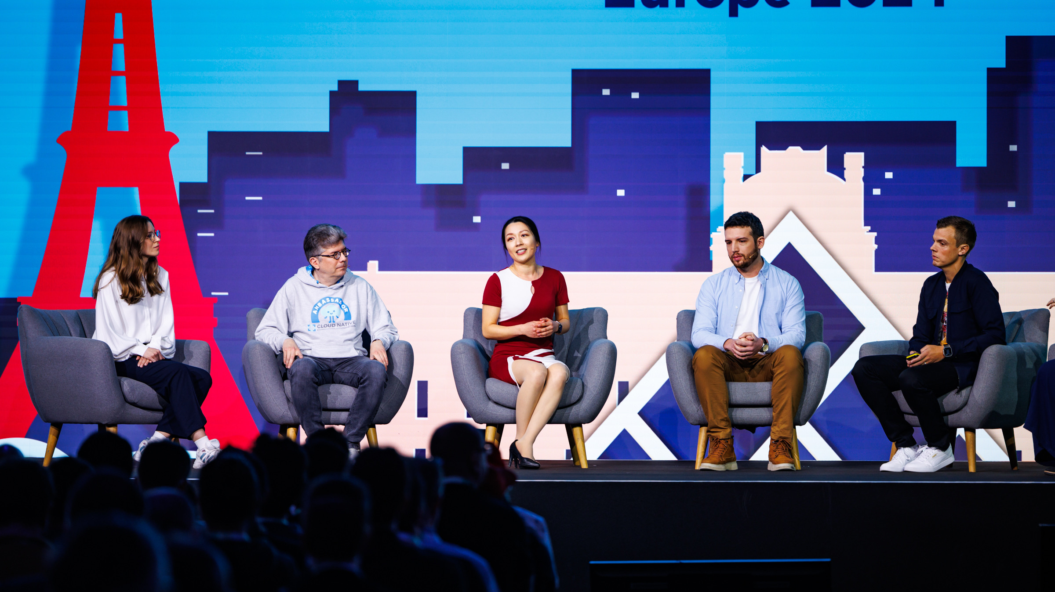
Different ways to get involved
jbrejnholt

Slide 25

Sum up
Background
The good, the bad and the ugly
Safe adoption
jbrejnholt

Slide 26



jbrejnholt

Slide 27
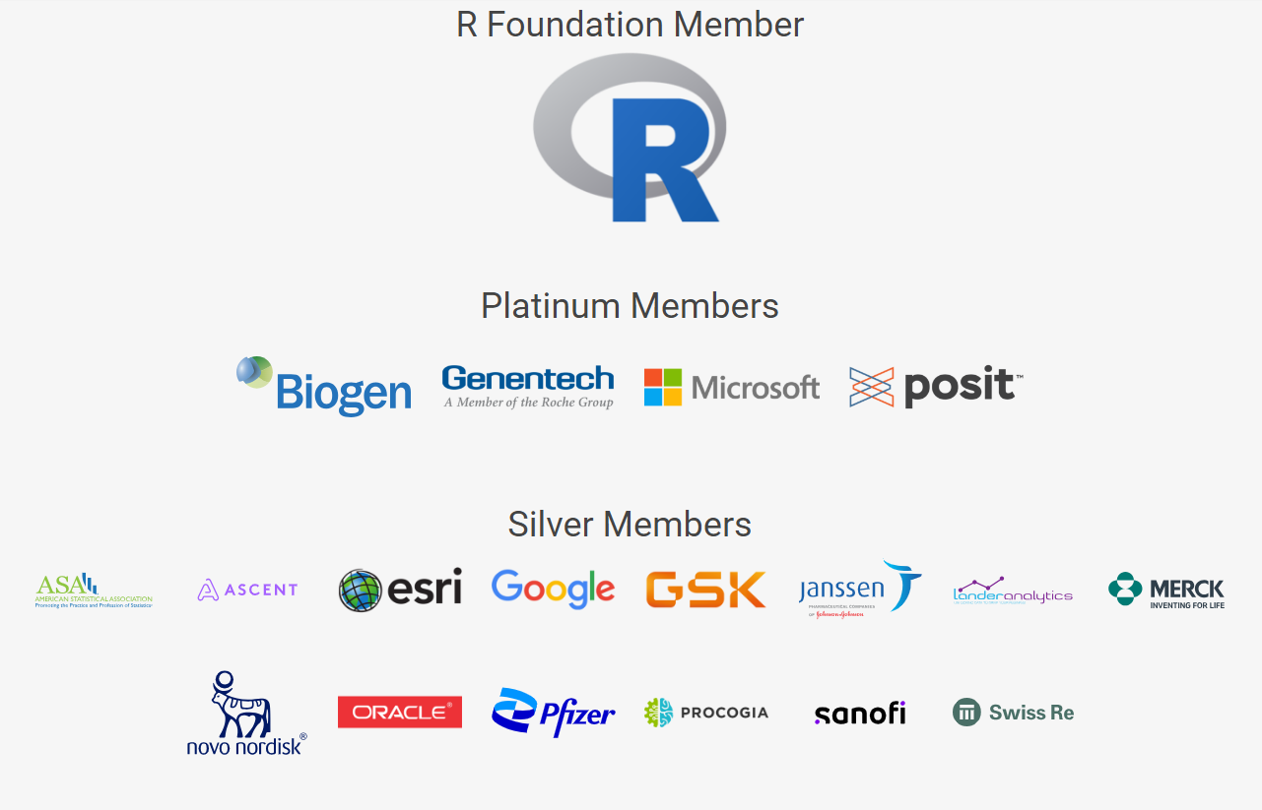
R Consortinum
https://www.r-consortium.org/members
jbrejnholt

Slide 28
PHUSE Video Series: Open Source Technologies in Clinical Data Analytics –Pfizer
Interview with Patti Compton, Vice President, Head of Statistical Analytics and Mike Smith, Senior Director, Statistics and Lead of R Centre of Excellence.
https://www.youtube.com/watch?v=CHEAVlGJYKg&t=755s
jbrejnholt

